Slide 1


Title Starts here use, Stag Book or
Stag Light 50pt.- 42pt.
Sub-Title starts here, use
Stag Book or Stag Light 36pt-28pt

Slide 2

Title Starts here use, Stag Book or Stag Light
50pt.- 42pt.
Sub-Title starts here, use Stag Book or
Stag Light 36pt-28pt
Body copy starts here, use Stag Sans Book 20pt. Body copy starts here,
use Stag Sans Book 20pt. Body copy starts here, use Stag Sans Book 20pt
Body copy starts here, use Stag Sans Book 20pt. Body copy starts here,
use Stag Sans Book 20pt.

Slide 3

Title Starts here use, Stag Book or Stag Light 52pt.- 56pt.
Sub-Title starts here, use
Stag Book or Stag Light 36pt-28pt
Sub-Title starts here, use Stag Book or Stag Light 24pt
Body copy starts here, use Stag Sans Book 18pt. Body copy starts here,
use Stag Sans Book 18pt. Body copy starts here, use Stag Sans Book 18pt
Body copy starts here, use Stag Sans Book 18pt

Slide 4
Title Starts here use, Stag
Book or Stag Light 50pt.- 42pt.
• Sub-Title starts here, use Stag Book or Stag Light 22pt-26pt
• Sub-Title starts here, use Stag Book or Stag Light 22pt-26pt
• Sub-Title starts here, use Stag Book or Stag Light 22pt-26pt
• Sub-Title starts here, use Stag Book or Stag Light 22pt-26pt
• Sub-Title starts here, use Stag Book or Stag Light 22pt-26pt
• Sub-Title starts here, use Stag Book or Stag Light 22pt-26pt

Slide 5


Title Starts here use, Stag
Book or Stag Light 52pt.- 42pt.
Sub-Title starts here, use
Stag Book or Stag Light 36pt-28pt
Sub-Title starts here, use Stag Book or Stag Light 24pt
Body copy starts here, use Stag Sans Book 18pt. Body copy starts here,
use Stag Sans Book 18pt.
Sub-Title starts here, use Stag Book or Stag Light 24pt
Body copy starts here, use Stag Sans Book 18pt. Body copy starts here,
use Stag Sans Book 18pt.

Slide 6
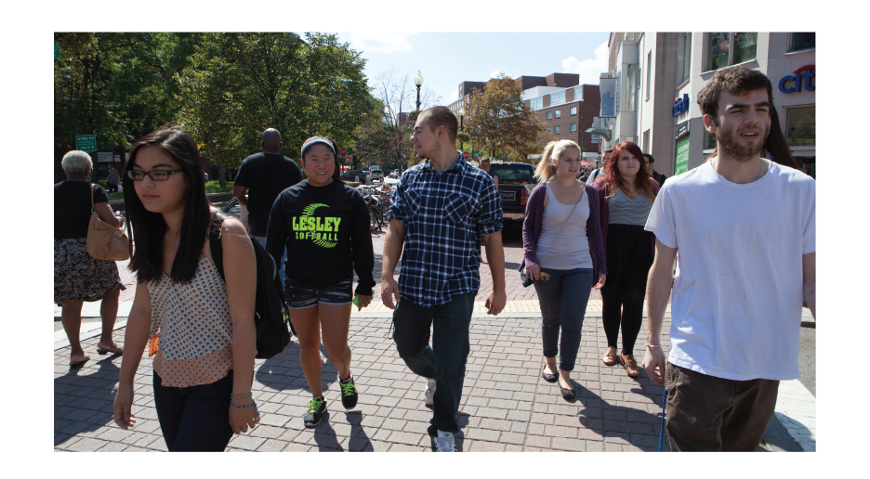

Title Starts here use, Stag
Book or Stag Light 50pt.- 42pt.
Sub-Title starts here, use Stag Book
36pt-28pt
Chart Title Here
Body copy starts here, use Stag Sans
Book 14pt. Body copy starts here,
use Stag Sans Book 14pt.

