Slide 1
Days under quarantine…
Ziyi Su/2020/Xi’an, China

Slide 2
Outing voucher
One person per household were allowed to go out.

Slide 3
Grocery shopping has become the only opportunity to go out

Slide 4
McDonalds closed

Slide 5
Empty streets
Downtown Xi’an used to be packed with traffic and tourists

Slide 6
These historical buildings has been standing here for hundreds of years. Have they ever witnessed something like this?

Slide 7
Spring festival lanterns
Lantern viewing used to be one of the most crowded festive events.

Slide 8
Finally found one that’s still open!
Only take away though. No dine in allowed. Getting McDonald’s, –what used to be the norm now feels like an adventure.

Slide 9
Protective measures…

Slide 10
Taxi driver in a plastic chamber

Slide 11
Used masks decorated
Smell the spring already?

Slide 12
Mask is the new essential.
-phone
-keys
-wallet
-mask

Slide 13
Creative problem solve
“toothpicks for button pushing only”
Photo collected from weibo

Slide 14
Sudden shortage of medical supplies
“no mask no sanitizer no disinfecting alcohol no thermometer”
Photo collected from weibo

Slide 15
Train station “safe distance” marks
Photo collected from weibo

Slide 16
Every passenger is registered upon arrival and tracked in the community.
Photo collected from weibo

Slide 17
Empty park
“Top order response,
crucial to life,
go home immediately,
in accordance to law.”
Photo collected from weibo

Slide 18
Photo collected from weibo

Slide 19
Life did not stop here.
Photo collected from weibo

Slide 20
Temperature is your new ID.
Photo collected from weibo

Slide 21
Photo collected from weibo

Slide 22
Photo collected from weibo

Slide 23
Empty streets.
Police patrols on empty streets while public security needs protection
on another level
Photo collected from weibo

Slide 24
Warriors of another kind
Medical workers received more respect and appreciation than ever
Photo collected from weibo

Slide 25
Many doctors and nurses worked long shifts to their extremes
Finally got to lie down after all patients were discharged from mobile cabin hospital …
Photo collected from weibo

Slide 26
Sharing a short moment of sunset on their way to a CT scan
Photo collected from weibo

Slide 27
Outside ICU
Photo collected from weibo

Slide 28
“The whistleblower”
Doctor Li Wenliang was a doctor at a hospital in Wuhan, the epicenter of the outbreak in China. He was among the very first to warn his medical colleagues about this new SARS-like virus emerging in his hospital. When his private messages hit the internet, Li was taken by the police for “spreading false comments.”
Li was regarded by people as a hero when his warning was to proven to be true. The night Li died of COVID-19, people brought flowers and cards to the hospital door to say farewell. Many more expressed their anger and sadness on social media about their wrongly treated whistleblower.
More info: https://www.nytimes.com/interactive/2020/04/13/technology/coronavirus-doctor-whistleblower-weibo.html
Photo collected from weibo

Slide 29
“Li WenLiang, rest in peace.
–A man of guilt lighten up by your glory.”
Photo collected from weibo

Slide 30
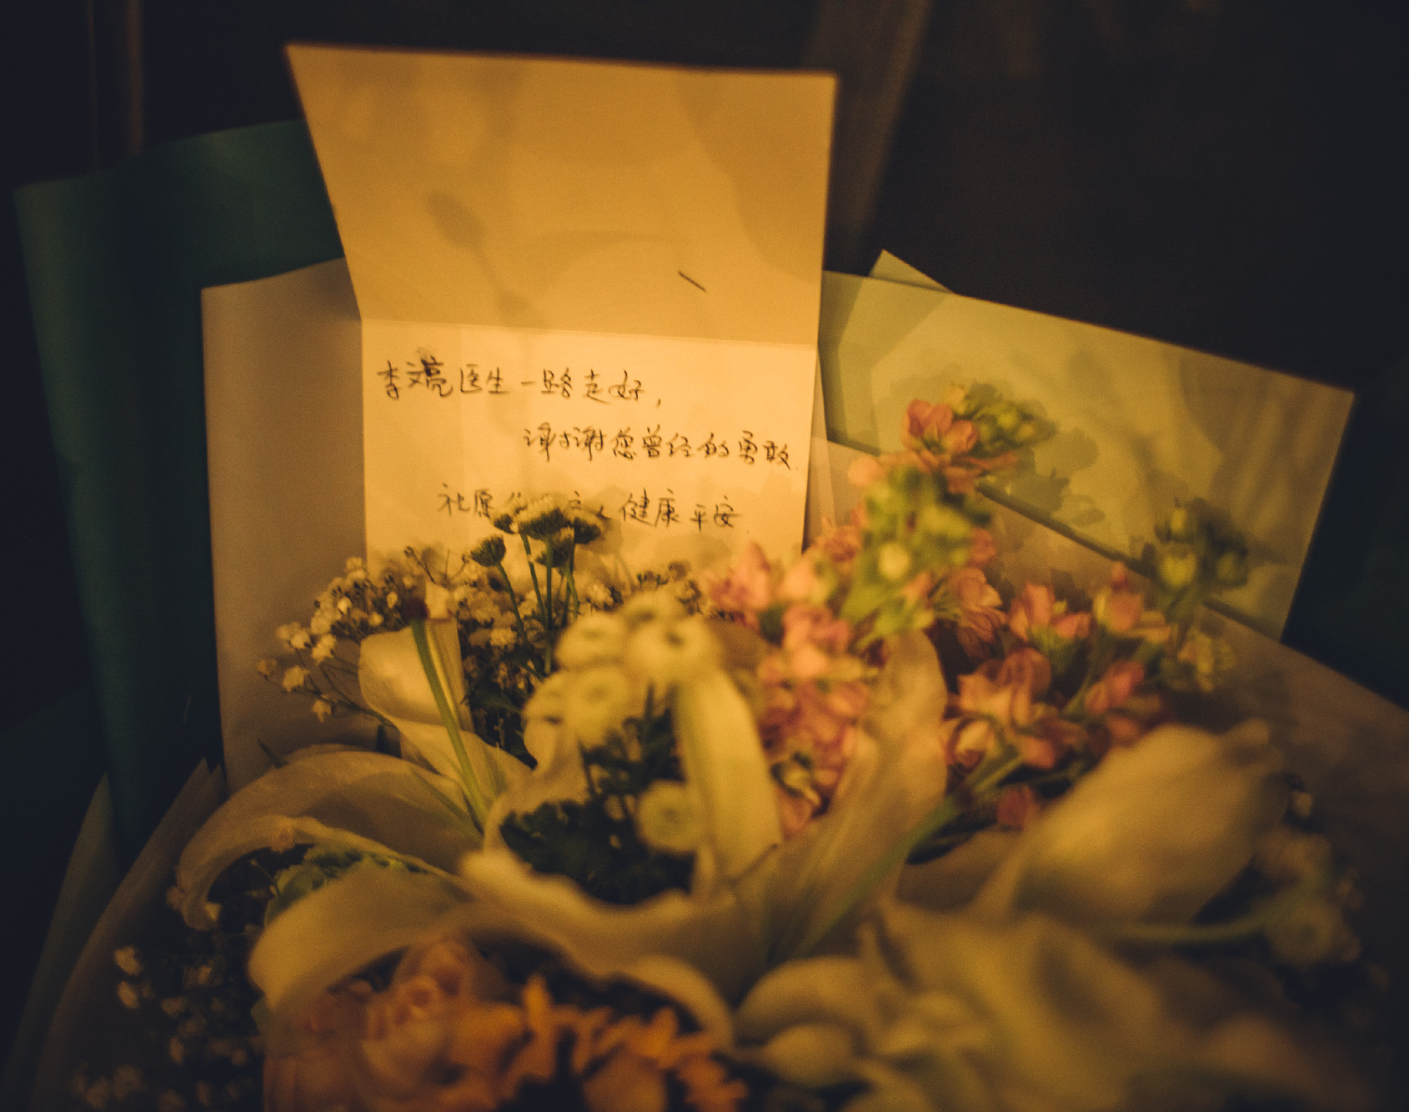
“Doctor Li WenLiang, farewell.
Thank you for your courage in the past.”
Photo collected from weibo

Slide 31
“Farewell to Li WenLiang!”
It was as though people were mourning over a loss of a part of themselves. Li lived an ordinary life like the rest of us but made conscientious and courage choices.
Photo collected from weibo

Slide 32
April 4th National mourning ceremony for lost lives in the COVID-19 outbreak
April 4th is QingMing Festival, the traditional ”Tomb Sweeping Day” in China. The day this year bears extra meaning in a period of public health crisis.
Photo collected from weibo

Slide 33
There were government organized events. But many more gathered on the streets voluntarily.
Photo collected from weibo

Slide 34
Photo collected from weibo

Slide 35
Photo collected from weibo

Slide 36
Photo collected from weibo

Slide 37
Photo collected from weibo

Slide 38
Photo collected from weibo

Slide 39
Photo collected from weibo

Slide 40
A drop of internet search engine data indicating the three minutes of silent mourning.
It was like a drop in heartbeat
which the whole country was feeling.
Photo collected from weibo

Slide 41
Popular sites and apps turned black and white in tribute
Bright colors like red are avoided during Chinese funerals.
Photo collected from weibo

Slide 42
In the meantime…
Internet pages during this period were often taken down for ”spreading false comments” or “causing disturbance”. What was deemed “sensitive” remained unspeakable on this day of reflection. Just not red.
Photo collected from weibo

Slide 43
April 4th and “404”
Some people found the sarcastic coincidence
Photo collected from weibo

Slide 44
“Thank you for fighting for us”
During the Wuhan quarantine, over 6000 medical workers came from all over the country to support the most dangerous frontline hospitals. When their work was done, people in Wuhan stood along the streets to say goodbye to their heroes.
Photo collected from weibo

Slide 45
Aftermath
When quarantine was lifted, people waited outside funeral homes to claim the ashes of their family members who passed away.
Bodies were sent straight from the hospital to be cremated. Funeral homes did not allow ceremonies during quarantine, so most people did not have the chance to say goodbye when their loved ones died.
Photo collected from weibo

Slide 46
How do we proceed from here?
Photo collected from weibo

